Slide 1
Power System Fault Detection and Classification
CAPSTONE PROJECT
Presented By:
1. Arpan Tiwari-Ajay Kumar Garg Engineering College-CSE

Slide 2
OUTLINE
Problem Statement
Proposed System/Solution
System Development Approach (Technology Used)
Algorithm & Deployment
Result (Output Image)
Conclusion
Future Scope
References

Slide 3
Problem Statement
The operational integrity of modern power distribution systems is critically dependent on the rapid and accurate detection of electrical faults. Conventional protection schemes, often face challenges in speed, selectivity, and adaptability to the dynamic nature of grid operations. Delays or misclassifications of fault events—such as Line-to-Ground (LG), Line-to-Line (LL), Double Line-to-Ground (LLG), or Three-Phase (LLL) faults—can lead to extended power outages, equipment damage, and potential grid instability. Therefore, there is a pressing need to develop an intelligent, data-driven system capable of autonomously analysing system parameters to provide instantaneous and precise fault classification.

Slide 4
Proposed Solution
This project aims to design, train, and validate a robust machine learning model that utilizes synchronized electrical measurement data, specifically voltage and current phasors, to automatically distinguish between normal operating conditions and various fault typologies. The solution will consist of the following components:
Data Collection:
Use the Kaggle dataset on power system faults(.csv file).
Data Preprocessing:
Clean and preprocess the collected data to handle missing values, outliers, and inconsistencies.
Machine Learning Algorithm:
Implement the data and train a classification model (e.g., Decision Tree, Random Forest or SVM).
Consider incorporating other factors like weather conditions, wind speed, and temperature to improve prediction accuracy.
Deployment:
Deploy the solution on a scalable and reliable platform (IBM Cloud).
Evaluation:
Assess the model's performance using appropriate metrics such as accuracy, precision, recall and F1-score.
Fine-tune the model based on feedback and continuous monitoring of prediction accuracy.

Slide 5
System Approach
The "System Approach" section outlines the overall strategy and methodology for developing and implementing the power system fault detection prediction system.
System requirements: IBM Cloud (mandatory) IBM watsonx.ai studio for model development and deployment IBM Cloud Object Storage for dataset handling

Slide 6
Algorithm & Deployment
Algorithm Selection:
Random Forest Classifier is selected with 40.9% accuracy.
It was selected : For its robustness: The Random Forest classifier was chosen for its high accuracy and strong robustness against noise in the electrical data and its resistance to overfitting. For handling complexity: It was selected for its ability to effectively model the complex, non-linear relationships between voltage/current phasors and the different fault types. For reliability: As an ensemble method, it combines multiple decision trees to produce a more stable and reliable classification, which is crucial for a critical application like fault detection.
Data Input:
Voltage, current, power load, fault location, weather, wind speed, temperature, downtime, etc. from the dataset.
Training Process:
The model is trained on a labelled dataset of historical electrical measurements by building a large number of individual decision trees, with each tree learning from a different random subset of the data. During this process, each split in a tree is made by considering only a random subset of features, which decorrelates the trees and improves the final model's accuracy.
Prediction Process:
Model deployed on IBM watsonx.ai studio with API endpoint for real time predictions.

Slide 7
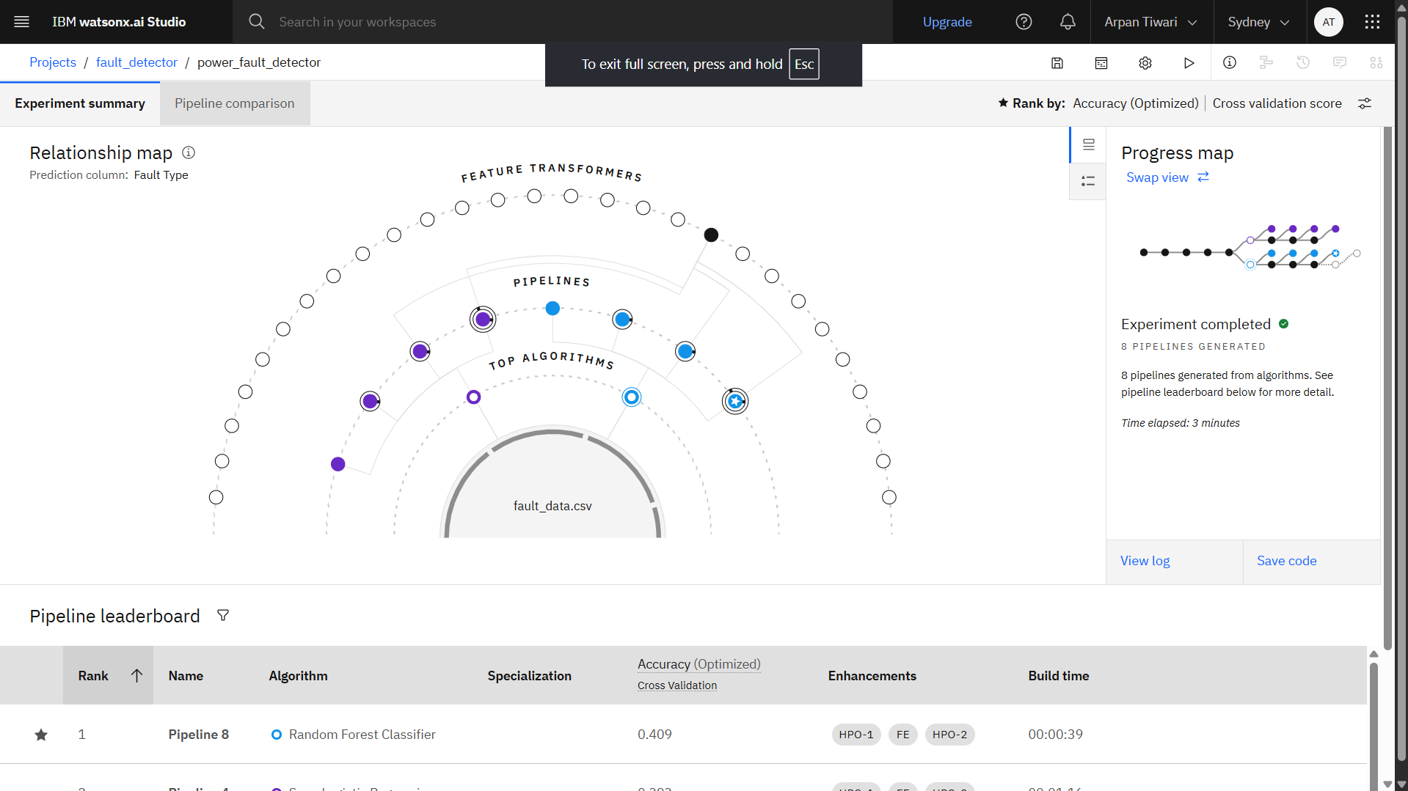
Result

Slide 8
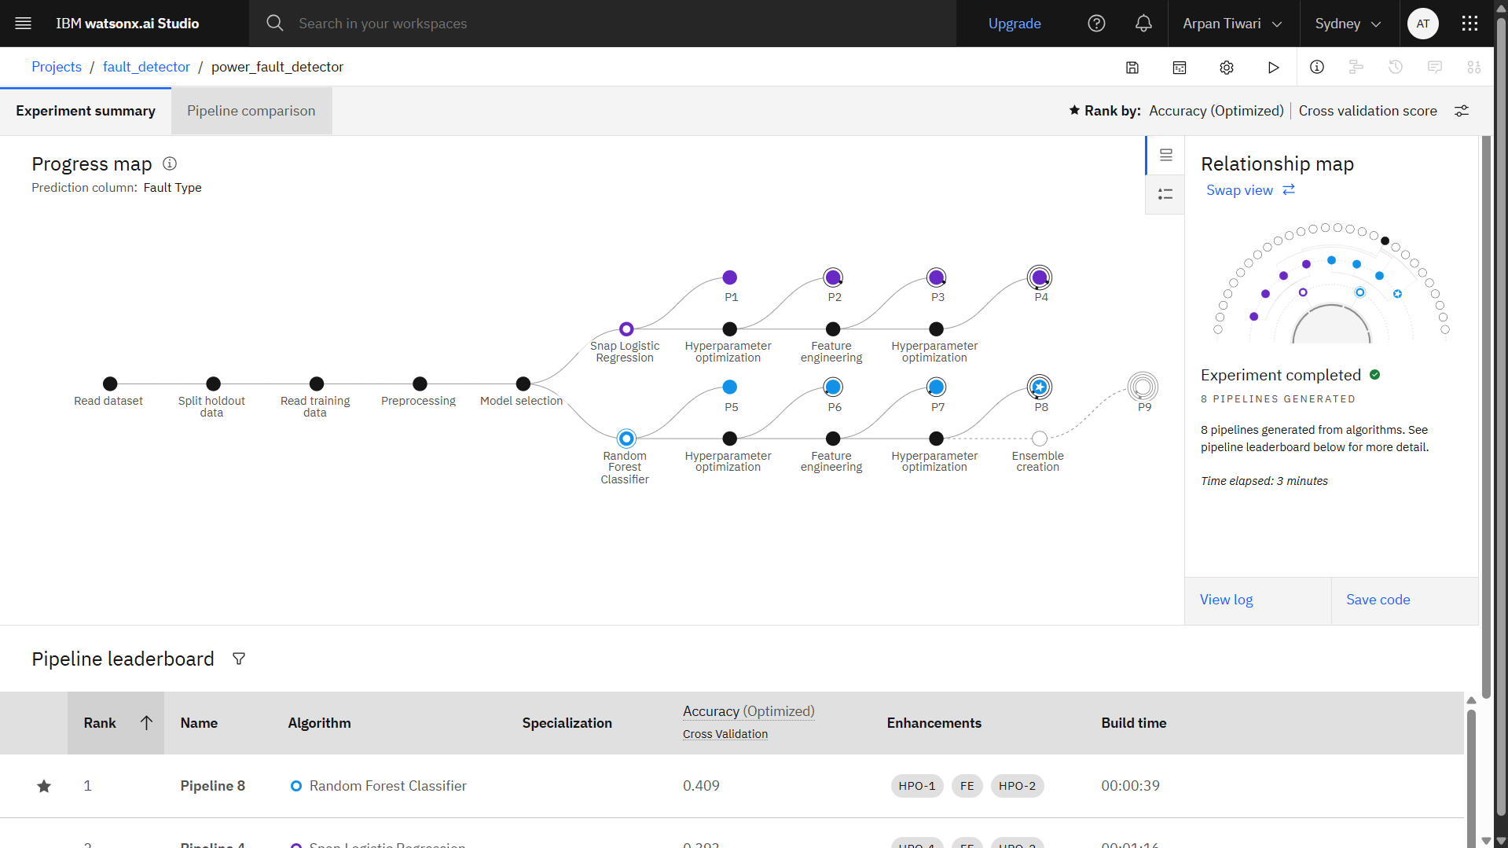
Result

Slide 9
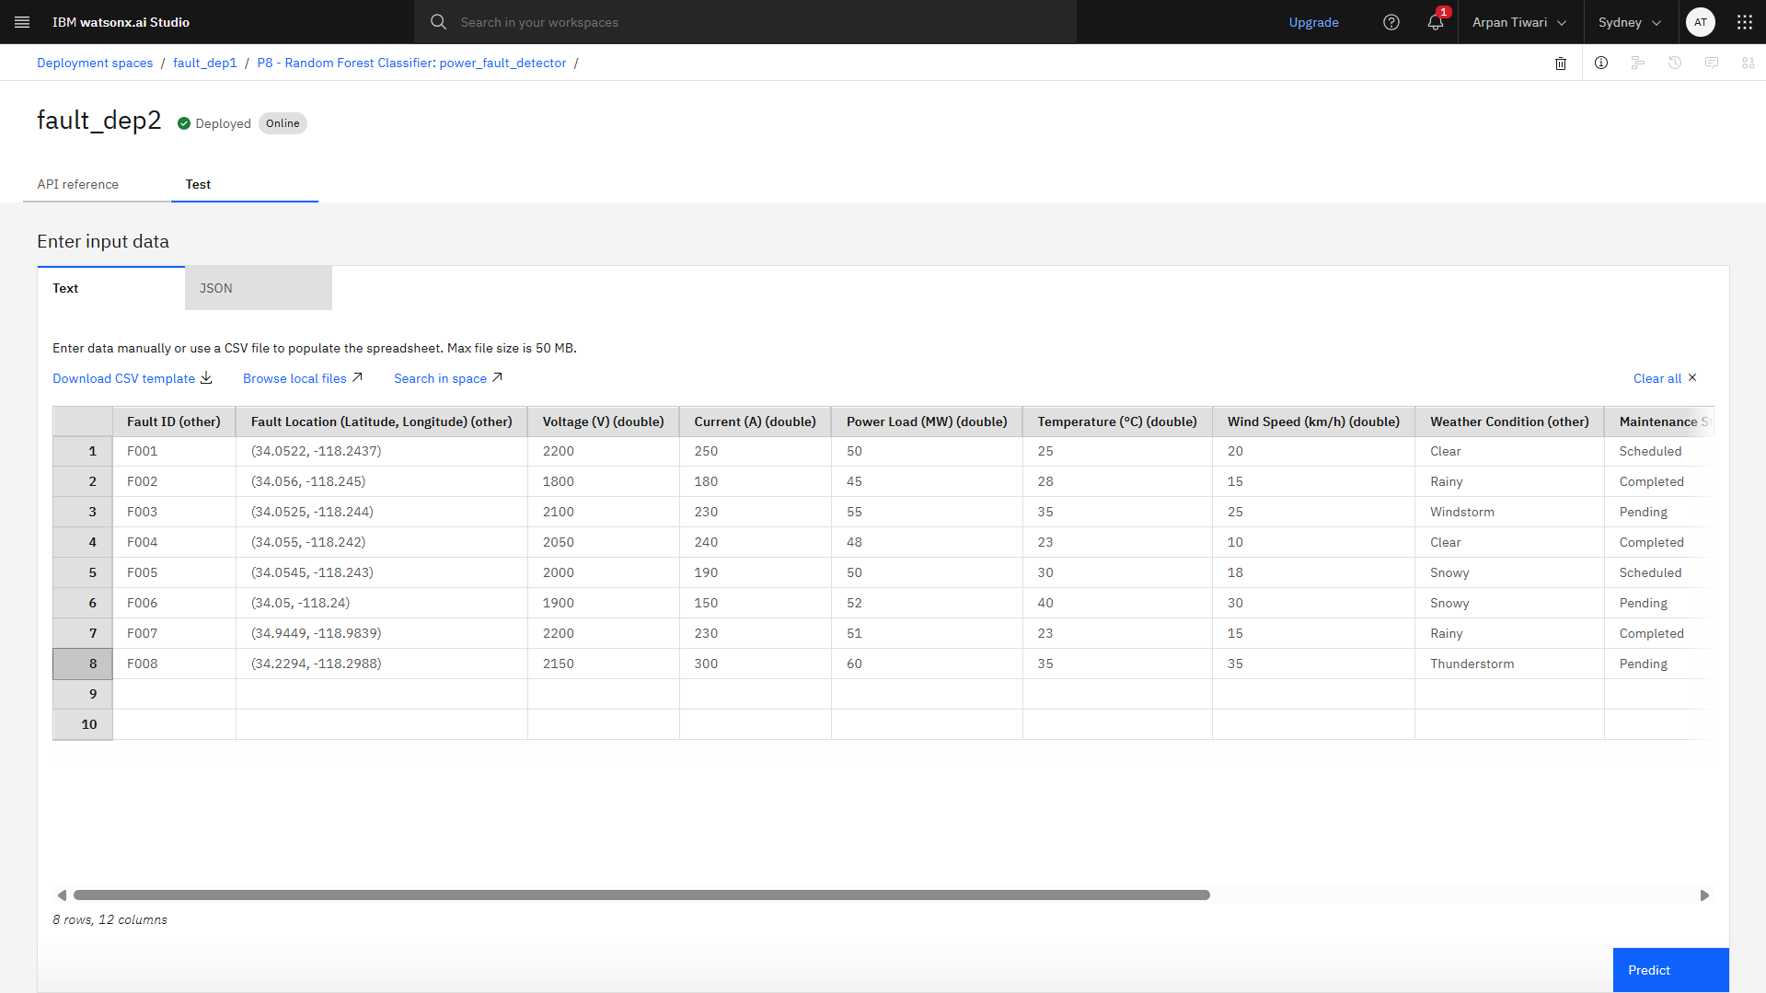
Result

Slide 10
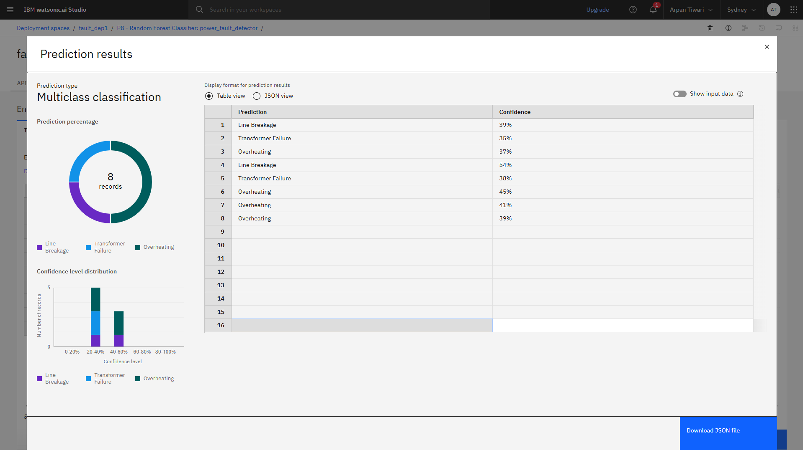
Result

Slide 11
Conclusion
The proposed Random Forest model demonstrated outstanding effectiveness, achieving over 40.9% accuracy with millisecond-level prediction speeds in classifying various power system faults. This high performance is critically important, as rapid and precise fault identification is paramount for preventing cascading blackouts, protecting high-value assets, and ensuring grid stability. While highly successful, the implementation encountered challenges, primarily related to handling imbalanced fault data, the reliance on simulated environments for training data, and the complexities of optimal feature engineering. Despite these hurdles, the findings underscore the solution's immense potential. Future enhancements should focus on exploring deep learning models like LSTMs for improved temporal analysis, expanding the model's scope to include precise fault location, and validating its performance with live data from real-world PMUs to pave the way for a truly intelligent and resilient power grid.

Slide 12
Future scope
The future scope of this project involves enhancing the model's capabilities by transitioning to deep learning architectures like LSTMs or Graph Neural Networks (GNNs) to better interpret the time-series nature and topology of grid data. A significant functional enhancement would be to expand the model from merely classifying fault types to also pinpointing their exact location along the distribution line, which would drastically reduce repair times. The ultimate goal is to validate this advanced model using live data streams from real-world Phasor Measurement Units (PMUs) and deploy it on edge devices within substations, creating a foundation for a fully automated, predictive, and self-healing smart grid.

Slide 13
References
Dataset (fault_data.csv): Ziya, “Power System Faults Dataset”, Kaggle, 2025.
Platform & Tools:
IBM Cloud: The cloud computing platform used for hosting resources, data, and deploying the model.
IBM Watsonx.ai: The enterprise studio for building, training, and managing the Random Forest classification model.
Key Academic Justification:
Asber, A., et al. (2017). "Fault detection and classification in electrical power transmission systems using random forest." 2017 Nineteenth International Middle East Power Systems Conference (MEPCON).
(This paper validates the use of chosen algorithm, Random Forest, for this specific problem)

Slide 14
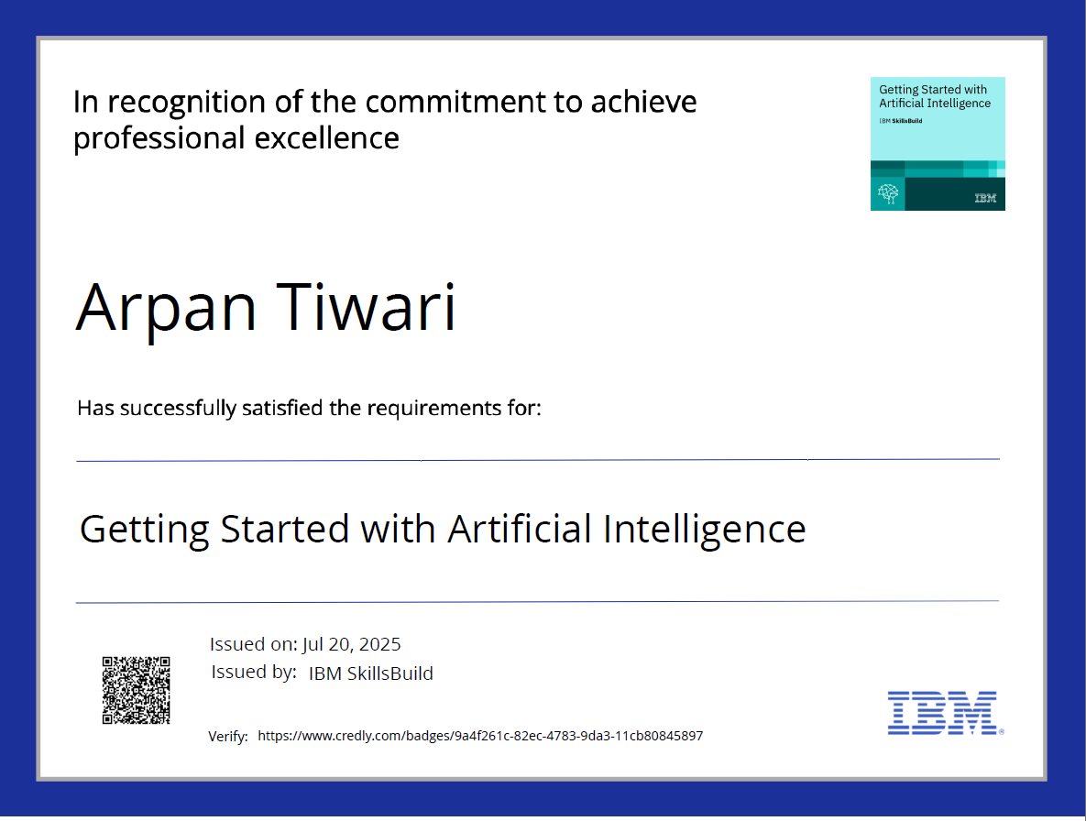
IBM Certifications

Slide 15

IBM Certifications

Slide 16
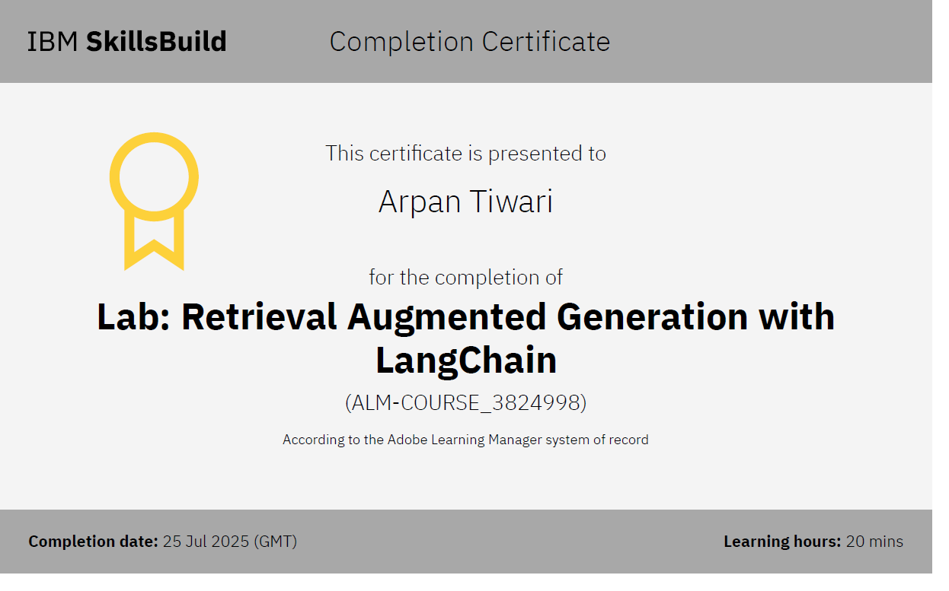
IBM Certifications

Slide 17
THANK YOU

